Slide 1

STATEMENT AUTHENTICITY ORDINAL CLASSIFICATION USING INTEGRATED SPEAKER’S TEXTUAL AND META DATA

Slide 2
PROBLEM STATEMENT AND MOTIVATION

Slide 3
BIG PICTURE
In the past years, we have become more and more bombarded by information from multiple sources thanks to the rise of the Internet. The huge amount of information we have at our fingertips and the freedom of the online world comes unfortunately with the downside of corrupted information, misinterpretations or plain lies.
During this COVID, we can see that people are circulating false news about the cure, affected and death among the country creating a panic situation.
The basic agenda behind this project, is to validate such false news and stop them from spreading.
Using the LIAR PLUS dataset, I planned to identify key features of lies and measure their spread in the online world. For some news we are not very certain about its authenticity therefore, instead of having binary classification as true or false, we have 6 classification.

Slide 4

OBJECTIVE
The research aims to design supervised learning model to address a particular blog/ news as fake or not based on its textual and meta data presented.
Moreover, If the news authenticity is not confirmed it will label it Ordinals like mostly true, half true, barely-true and False, thereby creating 6 labelled classification :
pants-fire, false, barely-true, half-true, mostly-true, and true.
Model can be used in social networking website to filter fake news.

Slide 5
RESEARCH QUESTIONS
Can a machine learning model classify statements based on surface-level Stylometric linguistic?
Can the model accuracy be improved, by preprocessing and integrating speaker’s Meta data along with textual data?
How accurately can the judgements made is predicted, when labels are considered as ordinal classifiers?

Slide 6
Evaluation Of Available Solutions
The Existing model created on this LIAR PLUS dataset, gave an maximum Accuracy of 34%.
The evaluation metrics used are Accuracy and F1 score which are nominal classification metrics and as the classification labels are related the metrics to be used is MSE, MAE, or some other ordinal metrics.
The existing models lack, feature selections which would help in better modelling like has_number, sentiments, emotions, speaker_details, Credit score, etc..
The modelling algorithm used are Linear regression, Logistic regression , SVM, Multinomial Naive Bayes classifier.
Deep learning models like RNN, CNN, LSTM and hybrid models are also used.

Slide 7
TECHNICAL CONTENT AND PROJECT EXECUTION

Slide 8

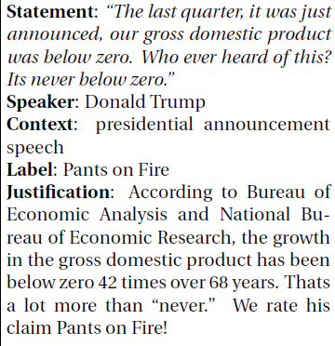
Data Collection
The LIAR PLUS dataset is web scrapped from POLITIFACT website by Wang, 2017 and is made available for use.
The extension to this dataset is LIAR PLUS which includes justifications of labels
It consisted of 21,836 data
Classification labels are : pants-fire, false, barely-true, half-true, mostly-true, and true.

Slide 9
Strategies And Approaches Used
Replaced missing values with appropriate value base on data analysis.
Data cleaning is done: Stopword, punctuations, special characters, etc. removal , Lemmatizing the words, etc.
Features like speaker, speaker job title and state have multiple values for same keywords which are merged. Also, speaker job title are grouped.
New significant features like Probabilistic sentiment and polarity, Emotions, Credit Score, has_number, etc are derived.
TF-IDF with 1-2 Ngram is used
GridSearch CV is used for hyperparameter tuning in different models. 5 fold cross validation is done.
New Evaluation metrics is designed for Ordinal Label
Basic model like Linear, Logistic, Naïve Bayes, SVM are used for model classification. Additionally, Deep learning model like LSTM and CNN are also used.

Slide 10
The model was trained over 10 epochs with a learning rate of 0.001 and drop out as 0.2, 0.5, 0.7
Pre-trained GloVe Word Embedding of 100 dimension is used for statements and justifications for deep learning models.

Slide 11
Defining The New Evaluation Metrics
The labels are categorical values i.e. pants-fire, false, barely-true, half-true, mostly-true, and true.
Categories in labels are closely related to each other therefore can be compared and sorted. Hence, considered as ordinal classification data. These multi-class classification data have inherit order between them and contains some meaningful difference. So the performance of such classifiers cannot be done by using measures / metrics of nominal classifiers
These ordinal classifiers correspond to quotations or linguist terms - varying from `True' to `Mostly false’.
These labels notifies the difference in correctness, recommendation, agreement or other characteristic of analyzed objects. An example can be agreement on a statement in a scale “strongly disagree” ≺ “disagree” ≺ “agree” ≺ “strongly agree”, where ≺ is the order relation.
In this case, labels are “pants-fire” ≺ “false ” ≺ “mostly false ” ≺ “half-true ” ≺ “mostly-true ” ≺ “true”
For Ordinal data classification, the metrics that are used are MSE( Mean Square Error) and MAE( Mean Absolute Error).
The existing metrics don’t have a range value, So in order to have a metrics which can be evaluated out of 100 %, we computed another metrics SSE.

Slide 12

$SSE=\frac{\sum_{i=1}^{n}{(Yi−ŷi)}2}{\sum_{i=1}^{n}{(\max\left(\left|Yi−0\right|,\left|Yi−5\right|\right)2}}$
$\sum_{i=1}^{n}{(\max\left(\left|Yi−0\right|,\left|Yi−5\right|\right)2}$ - Maximum misclassification that can occur
$\sum_{i=1}^{n}{(Yi−ŷi)}2$ - Sum of Square Error values
$Yi$ – Actual Value
$ŷi$ – Predicted Value

Slide 13
EXPLORATORY DATA ANALYSIS

Slide 14
Dealing Missing Values
S.No. | Features | Missing Data Count
1. | subject_data | 2
2. | Speaker | 2
3. | speaker_job_title | 3567
4. | state_info | 2749
5. | party_affiliation | 2
6. | Barely_true_count | 2
7. | False_count | 2
8. | Half_true_count | 2
9. | Mostly_true_count | 2
10. | Fire_counts | 2
11. | Context(value/location) | 131
12. | Description | 97
Features like , false_Count, barely-true-count, half-true_count, mostly-true_count, and true_count are replaced with value 0 as they are used for computing credit Score and maximum frequency of 0’s.
Features like subject_data, context and Description are replaced with “others” and are combined at latter stage for making the prediction.
party_affiliation missing data is replaced with “republician” based on maximum count.
Speaker_job_title missing data is replaced with values which are in close association (using ML model) to concerned speaker
state_info missing data is replaced with “others”.

Slide 15
Data Cleaning
Apostrophe removal, Splitting Attached Words, Removal of URLs, Standardization of words like “looooovvvvvveeeeeeee" which need to be replaced with “love“.
Object standardization - Acronyms and hashtags are indented and replaced with proper words using manual data dictionaries of such acronyms and hashtags.
All textual data is now lemmatized which is a Text Normalization technique

Slide 16
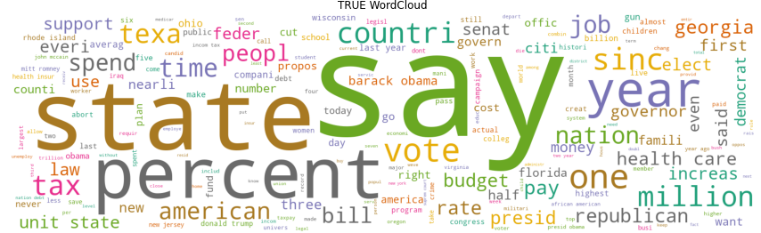
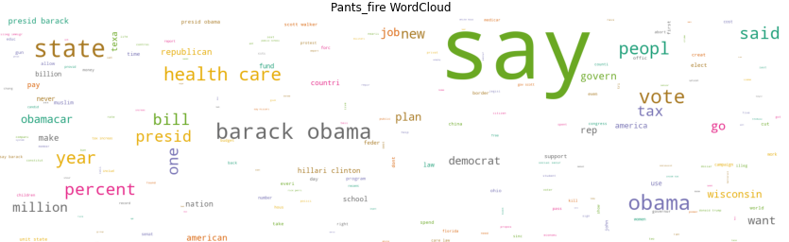
Text analysis using Word cloud
Insightful analysis is observed using word cloud analysis like for true we can see important subject and speakers which is used most.
But in contrast for False news these cannot be observed there is no association among subject.
For others news some associations can be seen .

Slide 17
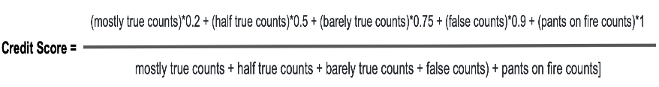
Meta-Data Features designed
Credit score: Based on the historical count of inaccurate statements by each speakers, a credit score is assigned to them
As the credit score will be high in case of a publisher who publishes fake news compared to the someone who does less.
Probabilistic sentiment and polarity. Sentiment/Polarity is a float which lies in the range of [-1, 1] where 1 means a positive statement and -1 means a negative statement.
Emotion lexicon: Extracting eight basic emotions (anger, fear, anticipation, trust, surprise, sadness, joy, and disgust)
Has_numbers : Whether the statement contains numeric value or not

Slide 18
Key Insights from Data
Most of the news coming from President are True.
States like Florida and Texas have recorded not only the most statement count but also most True statements
Maximum occurring topic are Healthcare, taxes, crime, economy and Elections.
Facebook posts, chain emails, and Donald Trump are drastically more likely to be 'pants-fire' lies.
News containing some form of a number or numeric values is true compared to the one missing.
Stylometric such as POS of popular users like Authors, President can also be used to identify articles.

Slide 19
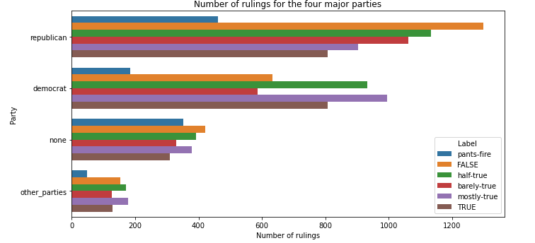
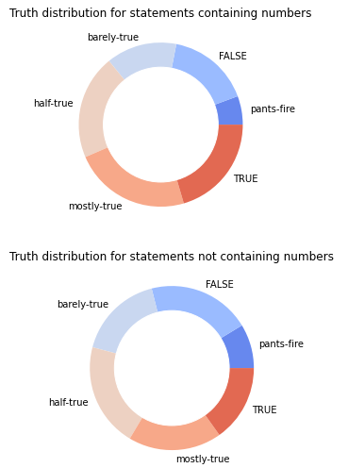
Analysis of features in relation to Labels

Slide 20
TESTING, EVALUATION, CRITICAL ANALYSIS AND CONCLUSIONS

Slide 21
Parameters results with best performing values, used for modeling
For Linar SVC,
LinearSVC(C =1.0, class weight =None, dual =True, t intercept =True, intercept, scaling = 1, loss ='squared hinge', max iter =1000, multi class ='ovr', penalty ='l2', random state = 0, tol=1e-05, verbose=0)
For Logestic Regression,
LogisticRegression(C =1.0, class weight =None, dual =False, t intercept =True, intercept scaling =1, l1 ratio =None, max iter=100, multi class ='warn', n jobs =None, penalty ='l2', random state =None, solver ='warn', tol =0.0001, verbose =0, warm start =False)
For Multilayer Perceptron (MLP) Classier
MLPClassier(activation ='relu', alpha=1e-05, batch size ='auto', beta 1 =0.9, beta 2=0.999, early stopping =False, epsilon =1e-08, hidden layer size sv =(30,), learning rate='constant', learning rate init =0.001, max iter =200, momentum =0.9, n iter no change=10, nesterovs momentum =True, power t =0.5, random state =1, shue =True,solver ='lbfgs', tol =0.0001, validation fraction =0.1, verbose =False, warm start =False)

Slide 22
For RandomForestClassier,
RandomForestClassier(bootstrap =True, class weight =None, max depth =None, criterion='gini', max features ='auto', max leaf nodes =None, min impurity decrease=0.0, min impurity split =None, min samples leaf =1, min samples split =2, n estimators=100, oob score =False, random state =42, verbose=0, warm start =False)
For XGBClassier,
XGBClassier(base score =0.5, booster =None, colsample bylevel =1, colsample bynod e=1, colsample bytree =1, gamma=0, gpu id =-1, importance type='gain', interaction constraints=None, learning rate=0.01, max delta step=0, max depth=6, min child weight=1, missing =nan, monotone constraints=None, n estimators =100, n jobs=0,num parallel tree =1, objective ='multi:softprob', random state =1, reg alpha =0, reg lambda =1, scale pos weight =None, subsample =1, tree method =None, validate parameters =False, verbosity =None)
CNN with filter size that worked well is (2,3,4) with drop out probabilities as 0.3,0.5 and 0.8 with 5 training epochs.
Deep learning model bi-LSTM with ReLU as activation function using 100 dimension embedding layer is used with ADAM optimizer and categorical cross entropy loss function with 10 epoches.

Slide 23
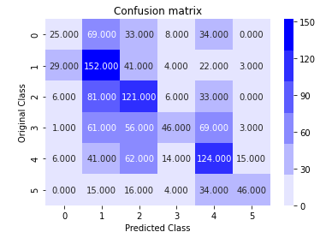



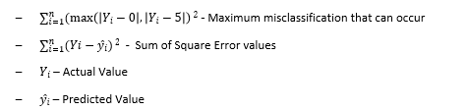
EVALUATION METRICS
The presented tabular show the Accuracy achieved using different Model using Ordinal and Nominal Evaluation metrics.
n – Total number of data
Accuracy= 1- SSE

Slide 24
MODELWISE COMPARISION
 | Nominal classification | Ordinal Classification
Model | Accuracy(%) | Error Evaluation |  |  | Accuracy(%)
 |  | MSE | MAE | SSE(%) | (1-SSE)
Naïve Bayes | 27 | 2.88 | 1.28 | 18.8 | 81.2
Linear SVC | 29.2 | 2.93 | 1.25 | 19.07 | 80.92
Logistic | 33.4 | 2.55 | 1.12 | 16.66 | 83.33
MLP | 29.9 | 2.84 | 1.22 | 18.50 | 81.4
RandomForest | 36.1 | 2.70 | 1.13 | 17.60 | 82.1
XgBoost | 38 | 2.28 | 1.09 | 15.60 | 84.40
CNN | 40.2 | 2.31 | 1.03 | 15.01 | 84.64
LSTM | 38.8 | 2.22 | 1.02 | 14.43 | 85.56

Slide 25
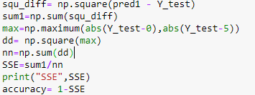
ACHIEVEMENTS
The model achieved the State Of Art Nominal Accuracy of 40.2% which is 6.2% higher then the existing model.
The new evaluation metrics for data classification is finalized and the accuracy achieved is 85.56%
.
Accuracy = (1 – SSE)
Significant new features are extracted which helped in achieving better accuracy.

Slide 26
CONCLUSION
Grouping of values for meta data like Speakers_job_title, Party and selecting top K values from features, helped in Modelling.
Classification of Ordinal data with nominal metrics give a very low evaluation which is a wrong approach. With Ordinal metrics the Accuracy achieved is 85.56%.
Hot Topic of News are on HealthCare, Economy, Election, Crime and taxes.
Social Media Played a major role in Fake News Circulation.
Bi-LSTM model outperformed with an accuracy of 85.56% , 1% higher than best performing Ensemble ML model –XgBoost
Evaluated the hyperparameters, used in different ML models for better modelling and latency, with defined dataset size and features.
Trinity College Dublin, The University of Dublin

Slide 27
Go Raibh Maith Agat
Ceisteanna?

